Slide 1

Error Ellipses
Prototype 1

Slide 2
Interface and it’s logical flow Things that we shall be discussing in this presentation
Why go for the first prototype?
How the user will be able to navigate through the interface to plot error ellipses
How the user will be able to save the data

Slide 3
Why go for the first prototype?
Buttons are always visible to the client and not hidden behind the menu bar.
The interface is easier to use.
More user friendly.
Better design.
Aligned better with the goals required.

Slide 4
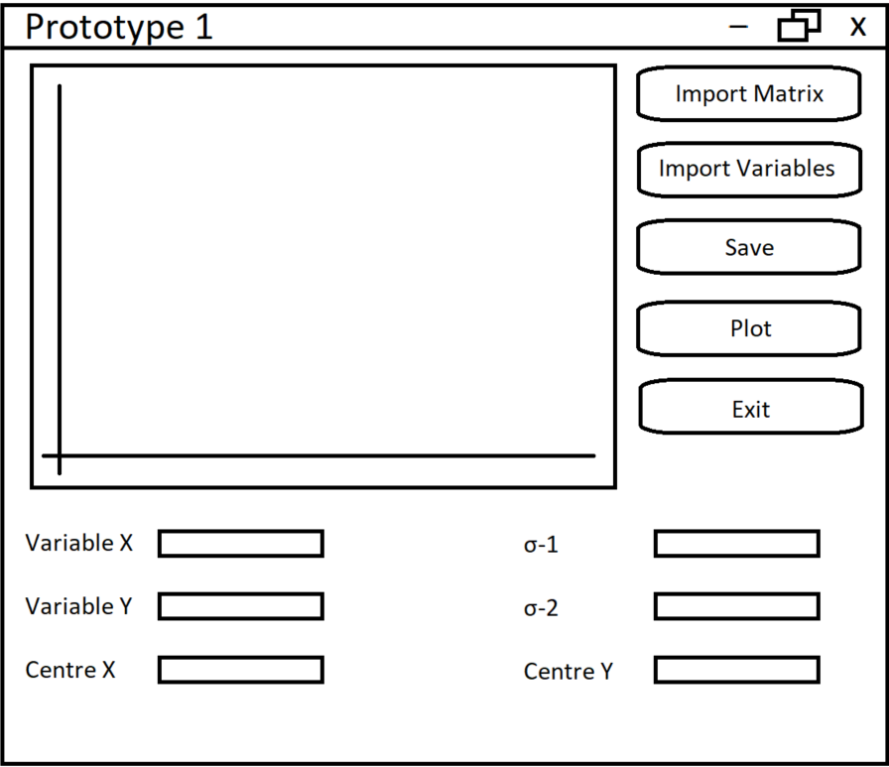
Interface
This is the main interface
User can:
Import covariance matrix
Import variables
Save the plotted data
Plot the data
Exit the program
Enter the parameter combinations for X and Y
Enter the centre for the ellipses
Enter confidence level

Slide 5
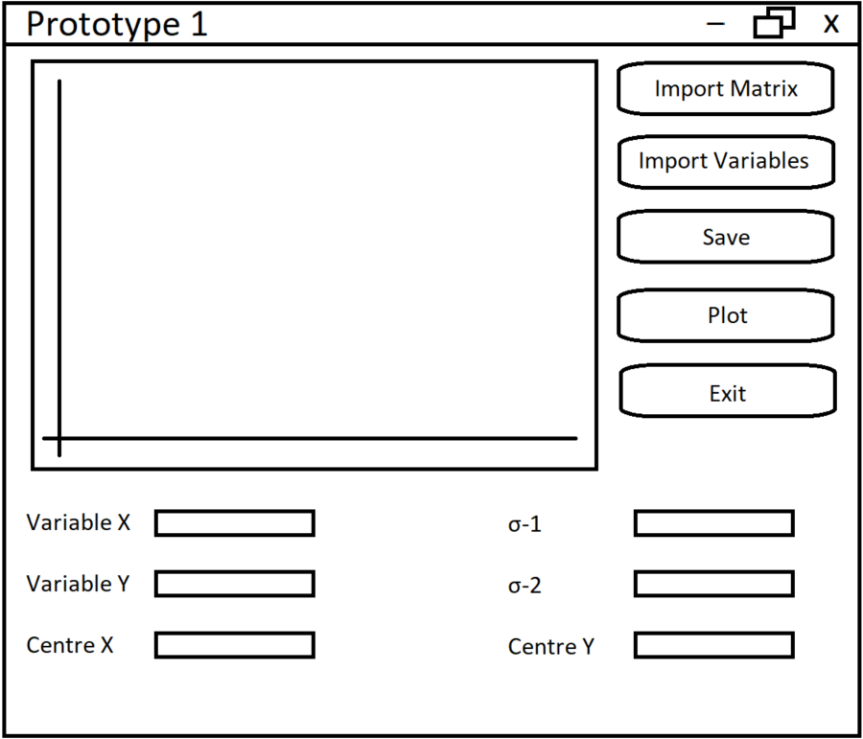
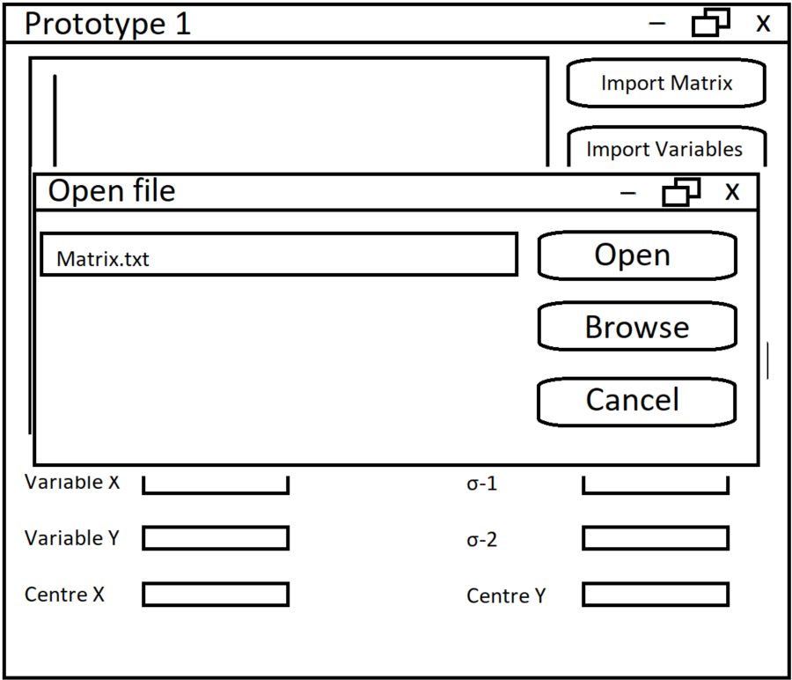

Importing the matrix

Slide 6

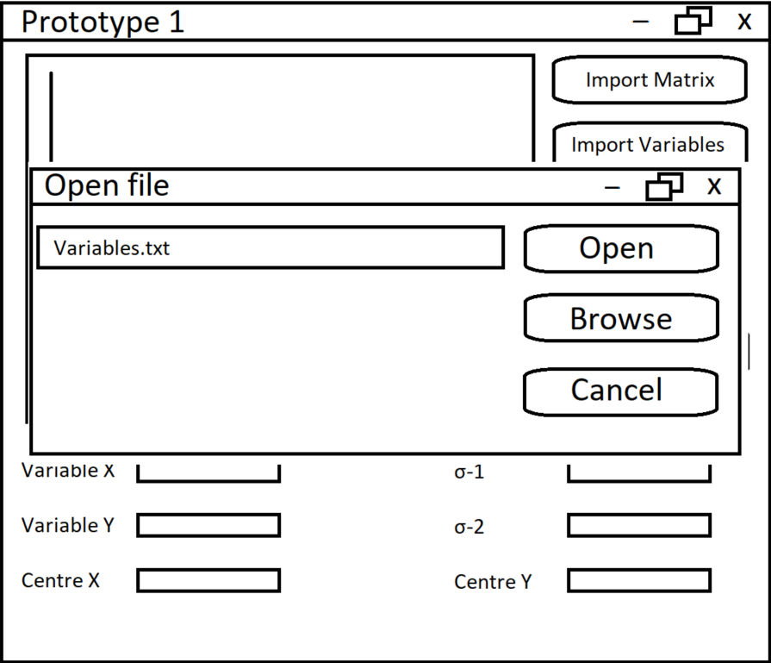
Importing the variables

Slide 7
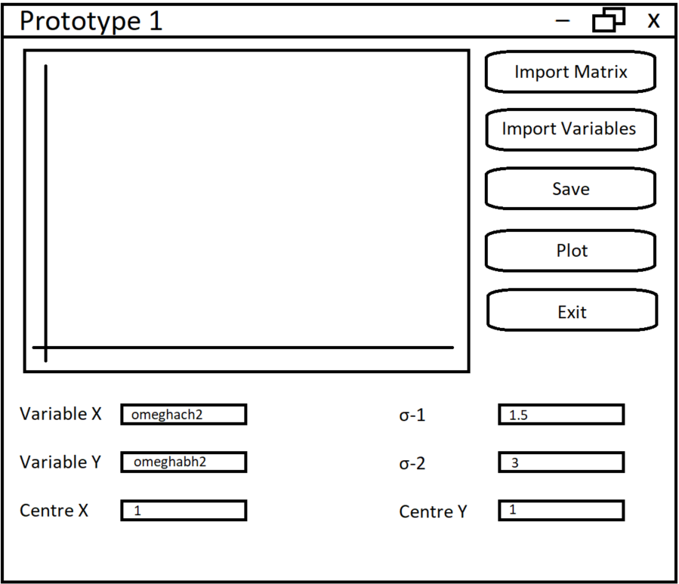
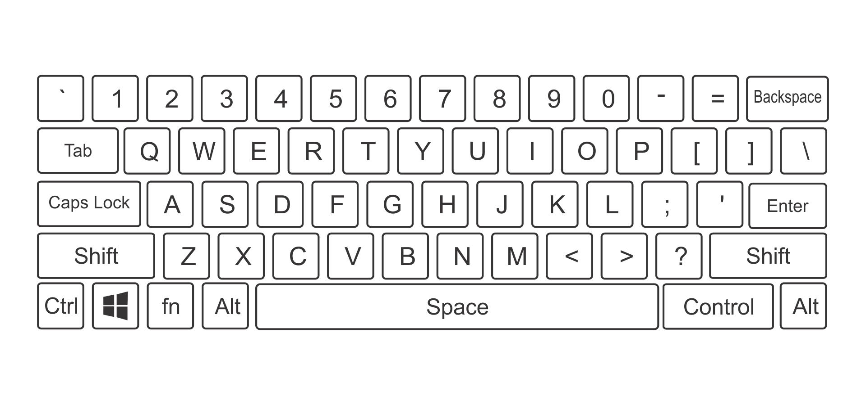
Setting the parameters

Slide 8
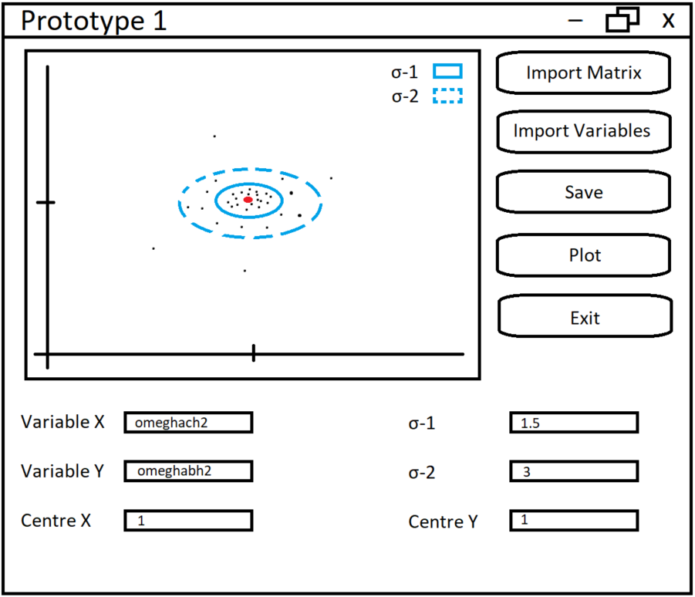
Plotting

Slide 9
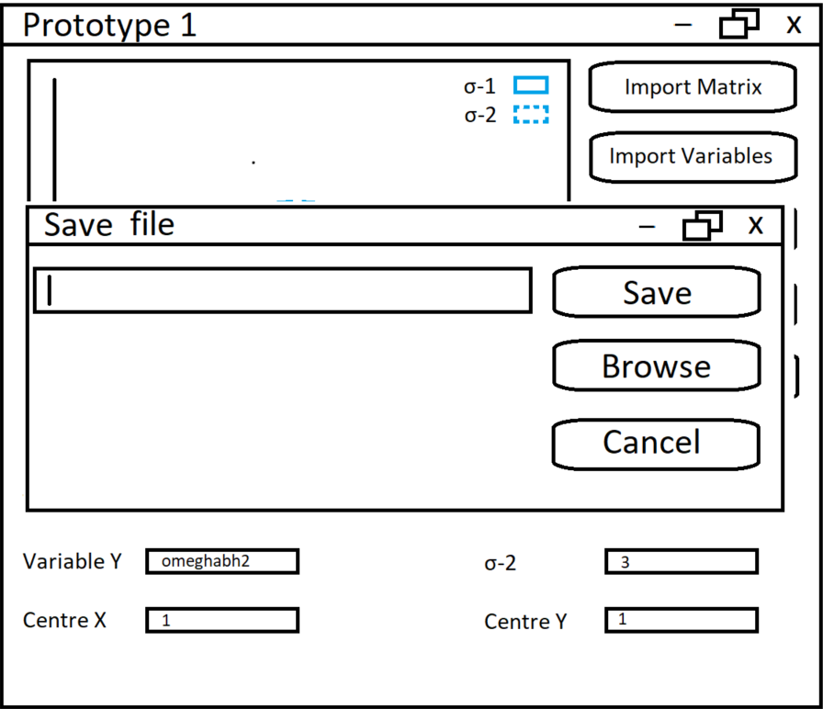
Saving

Slide 10
Exiting

Slide 11
Q & A, feedback and suggestions
Any questions?
Feedback and suggestions?

